Slide 1
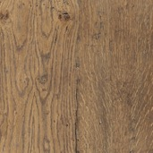
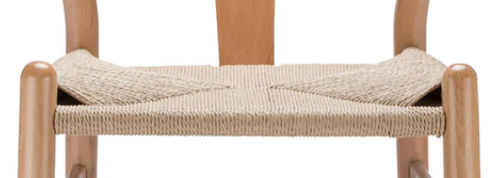
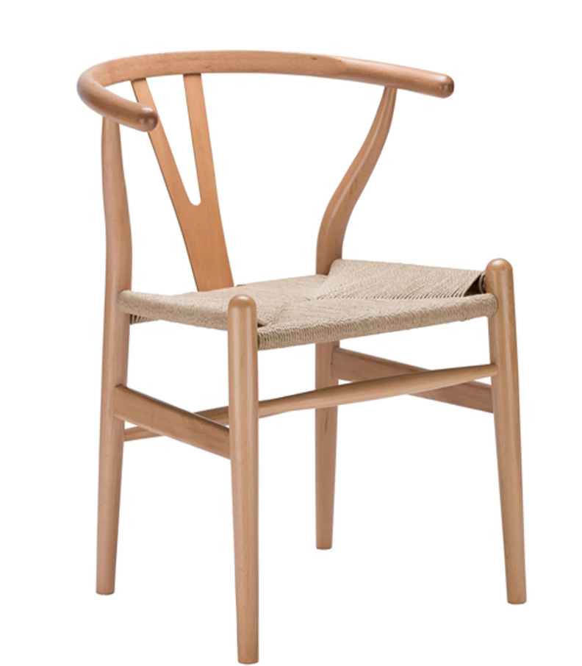
Wishbone Dining Chair
Target Retail: $179.99
KD
Rustic Natural wood
Natural rope seat
Rustic Natural
Natural colored rope seat

